Slide 1
Sales & Marketing Dataset
Team 5

Slide 2
Problem:
The company collects a huge amount of sales data from different regions, customer segments, and product categories. Without proper analysis, it becomes difficult to understand which regions generate the highest revenue, how advertising affects sales, and which customer segments contribute the most to revenue
Proposed Solution:
We developed an interactive Sales Analysis Dashboard that transforms raw sales data into meaningful business insights. The solution includes data cleaning, analysis using Excel, SQL, and Python, and visualization with Power BI. The dashboard enables decision-makers to monitor revenue, advertising costs, customer segments, regional performance, and seasonal sales trends in real time.
Unique Value Proposition:
Interactive and user-friendly dashboard.
Real-time sales performance monitoring.
Easy comparison between regions and customer segments.
Clear visualization of advertising costs and revenue.
Supports data-driven decision-making.

Slide 3
Project Objectives:
Analyze sales performance across different regions.
Compare customer segments and product categories.
Evaluate online and offline advertising costs
Identify seasonal sales trends
Build an interactive Power BI dashboard.
Support business decision-making with data-driven insights.

Slide 4
Dataset Overview
Source:(Kaggle)

Slide 5
Excel Analysis
Data Preparation
  Imported the dataset into Excel.
  Removed duplicate records.
  Handled missing values.
  Corrected data types.
  Standardized text values.
  Prepared the dataset for SQL, Python, and Power BI analysis.
Tools Used
  Microsoft Excel
  Power Query

Slide 6
SQL Analysis
Database Setup
  Created the MarketingDb database
  Imported a dataset containing 60,000 records.
Data Quality Check
  Identified missing values using SQL queries.
  Checked NULL values across key columns.
Data Cleaning
  Replaced missing values using AVG() with UPDATE statements.
  Preserved all records without deleting any rows
Database Objects
  Created an INNER JOIN with the Satisfaction_Levels table.
  Created the v_CleanedMarketingSummary view for Power BI reporting.

Slide 7
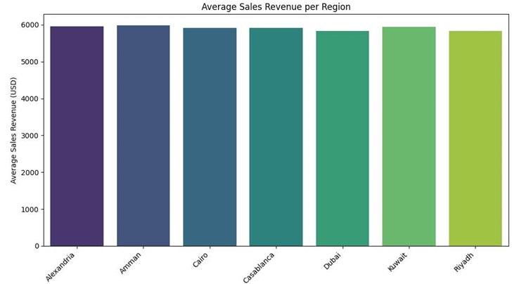
Python Analysis
Average Sales Revenue by Region
  Interpretation:
  This chart compares the average sales revenue across different regions.Some regions achieved higher sales than others .This helps identify the best-performing regions.

Slide 8
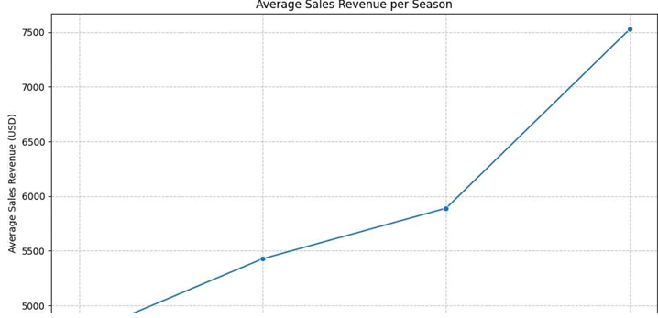
Average Sales Revenue by Season
  Interpretation:
  This chart shows how sales revenue changes across different seasons.Some seasons have higher sales than others .Seasonal trends can help improve marketing strategies.

Slide 9
Power BI Dashboard
Dashboard Overview
  This interactive dashboard provides a clear overview of the marketing and sales performance through KPIs, regional analysis, customer segmentation, and seasonal trends.
Key Insights
  Cairo recorded the highest sales revenue
  Regular customers represent the largest customer segment.
  Sales revenue reached its highest level in Q4.
  KPI cards summarize the main business metrics

Slide 10
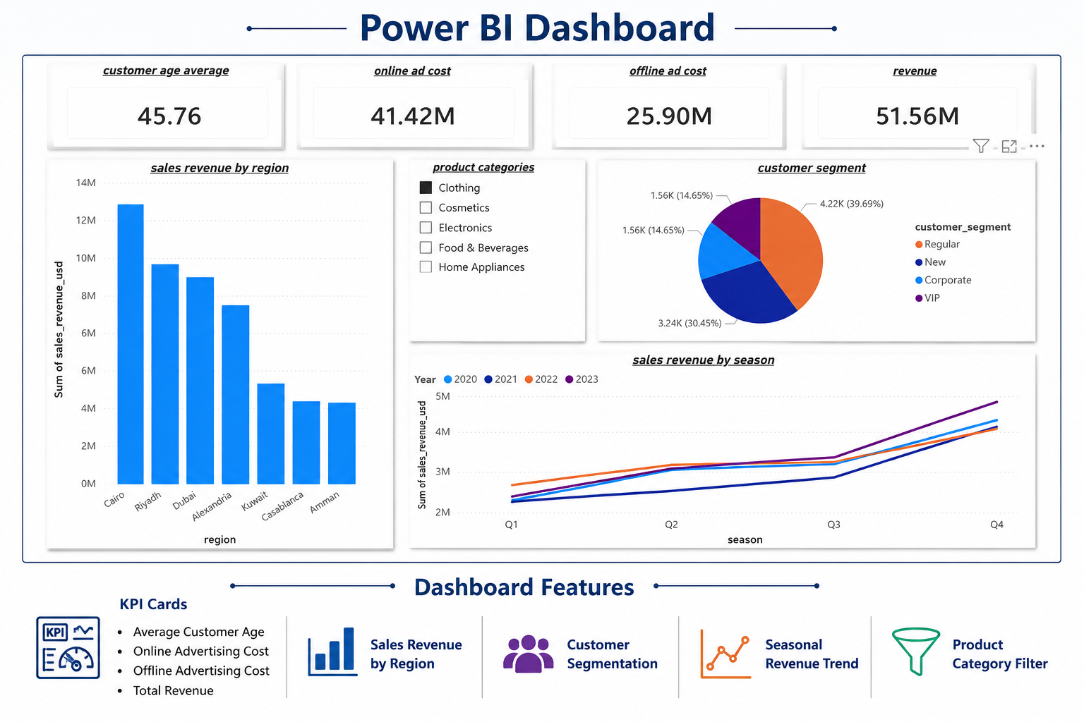

Slide 11
Increase Investment
Increase marketing investment in high-performing regions, especially Cairo, to maximize revenue.
Customer Loyalty
Introduce loyalty and reward programs to convert Regular customers into VIP customers.
Recommendations
Seasonal Campaigns
Launch more marketing campaigns during Q4, as it generates the highest sales.
Online Advertising
Optimize online advertising campaigns to improve ROI and reduce unnecessary costs

Slide 12
Project Team

